Slide 1

Project analysis slide 3
Stack Overflow Retrieval System with Multilingual Support using Approximate Nearest Neighbor
CIS600: Project Presentation
Aswarth Kanuri (240092396)
Deepthi Jagalur Vishwanath (376826242)
Shreyas Narasipura Indhudhara (228897558)
Sushmitha Shivakumar (484575804)
SUJAY VISHWANATH MALGHAN (314885101)

Slide 2
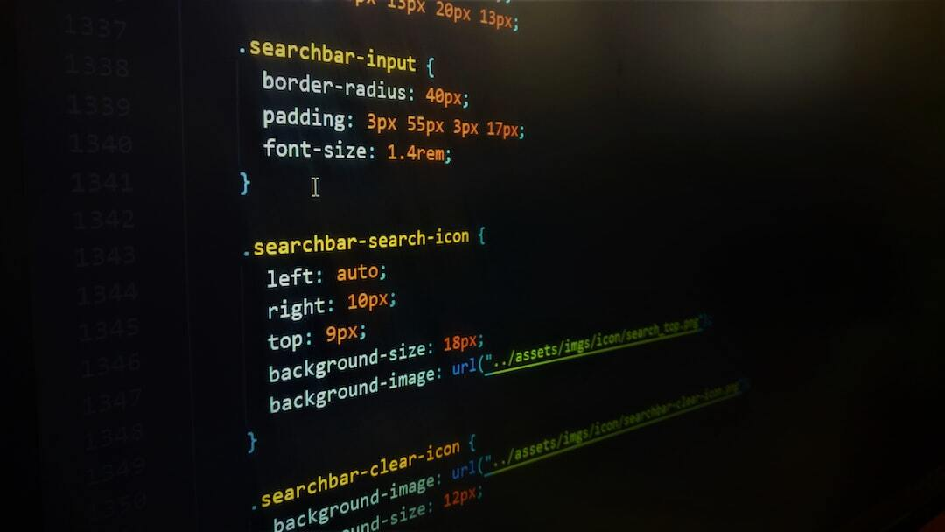
Introduction
Overview: The project aims to develop a sophisticated system to efficiently and accurately find related answers from the Stack Overflow database.
Purpose of the System: With the exponential growth in the volume of questions and answers, the challenge of efficiently matching users' queries with the most relevant existing content has become increasingly pronounced.
This project presents a comprehensive solution aimed at enhancing the question retrieval process on Stack Overflow by employing a multi-faceted approach. The system is designed to provide precise and contextually relevant search results by understanding the semantic meaning of queries.

Slide 3
Features
Technological Foundations: Utilizes Sentence Transformers for generating textual embeddings and Annoy for indexing these embeddings to facilitate fast and efficient similarity searches.
Multilingual Query Support: We have implemented a translation feature that converts user search queries into English, ensuring broad accessibility and understanding regardless of the user's native language.
BigQuery Integration: We have integrated Google's BigQuery to manage and query large datasets efficiently. This allows for rapid retrieval of relevant questions and answers from a vast database.
Target Users: Aimed at developers and programmers who require quick and accurate answers to technical queries, enhancing their productivity and learning.

Slide 4


Project analysis slide 3
Methodology
HTML Parsing and Text Extraction:
Tokenization and Normalization:
Data Collection
Data Cleaning
Generating embeddings
& Similarity Search
Removing all HTML tags and retrieves just the plain text from the HTML content.
After extracting the text, the next step involves cleaning it using a regular expression which removes all characters except basic alphanumeric characters (letters and numbers) and white spaces.
The text is split into tokens and then joined back into a single string resulting in clean preprocessed data.
Stack Overflow data collection
After cleaning, embeddings are generated for dataset. When posed with a question, similarity search is performed.

Slide 5
Technologies Used
AnnoyIndex
xml.etree.ElementTree
SentenceTransformer
A Python framework designed for generating sentence embeddings, facilitating tasks like semantic search, clustering, and information retrieval.
Annoy (Approximate Nearest Neighbors Oh Yeah) is a C++ library with Python bindings to efficiently search for points in space that are close to a given query point.
Library that provides tools for parsing and creating XML data in a simple and efficient manner.

Slide 6
Technologies Used
BeautifulSoup
Embeddings
In machine learning, embeddings are dense representations of items (like words, sentences, or images) in a continuous vector space, used to capture semantic meanings and relationships
translatepy
BigQuery
Google's serverless, highly scalable, and cost-effective multi-cloud data warehouse designed to process and analyze large datasets using SQL.
Python library for parsing HTML and XML documents, widely used for web scraping as it provides simple methods for navigating, searching, and modifying the parse tree.
Python library that offers a simple way to perform translations and language detections, interfacing with multiple translation engines.

Slide 7
implementation
Data Extraction: Parsing questions and answers from a Stack Overflow XML dump.
Semantic Processing: Utilized the Sentence-BERT model to generate semantic embeddings for the extracted text.
Efficient Indexing: Annoy indexing for the embeddings to facilitate rapid nearest-neighbor searches.
Database Integration: Configured data storage in Google BigQuery, optimizing for scalability and query efficiency.
Application Development: Built a Flask web application to serve as the user interface for data interaction.
Query Translation and Matching: Implemented translation of user queries into English, followed by embedding generation and similarity matching.
User Interface: Designed the application to display relevant search results dynamically on a web page.
Feedback Mechanism: Established a route in the Flask application to collect and process user feedback.

Slide 8
Future Enhancements
Hybrid Embedding Approach: Using a combination of Sentence-BERT and CodeBERT embeddings to capture both the semantic meaning and the technical specificity of the content.
Automated Content Moderation: Use machine learning to automatically flag or remove outdated, incorrect, or low-quality content

Slide 9
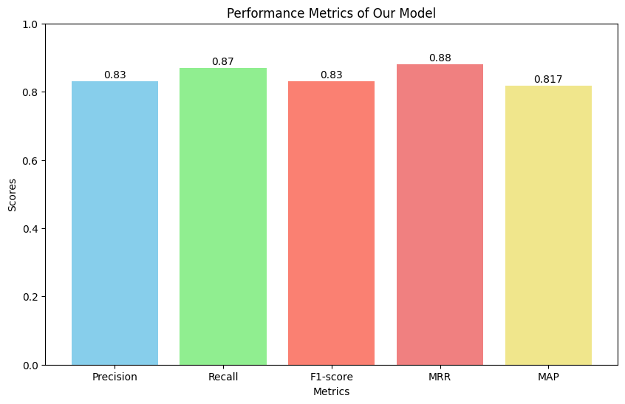
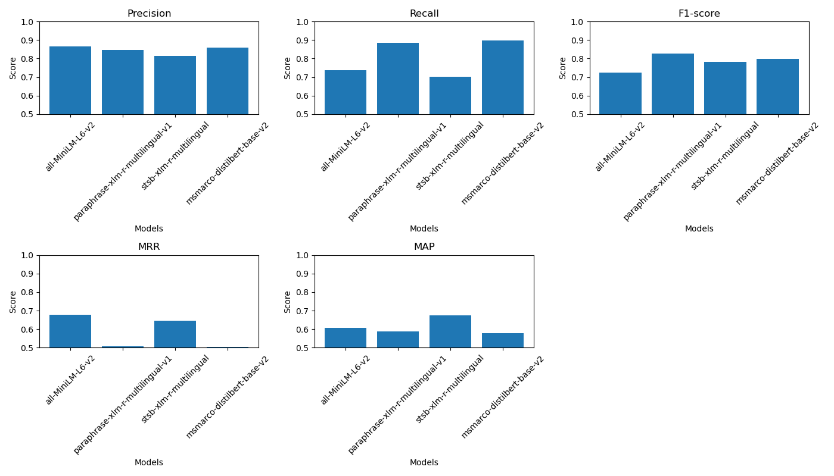
Model Evaluation
Metrics: Use precision, recall, F1-score, Mean Reciprocal Rank (MRR), and Mean Average Precision (MAP) to measure performance.
Ground Truth: Known correct answers for comparison.
Process: Assess how well the system's predictions match the ground truth.
Interpretation: Analyze results to understand model performance and identify areas for improvement. MRR(Mean Reciprocal Rank) indicates the quality of the top-ranked result, while MAP gives an average measure of the ranking quality across all queries.
Our Model: all-MiniLM-L6-v2 Other model comparisons: 'paraphrase-xlm-r-multilingual-v1': Can't adapt well to specific tasks or topics because it learns generally across many languages.
'stsb-xlm-r-multilingual': May not understand subtle differences between words as well because it's not as complex as bigger models.
'msmarco-distilbert-base-v2': Might not understand language as deeply because it's a simpler version of a more complex model.

Slide 10
THANK YOU

